Slide 1
IFRS® Foundation
Disclosure Initiative Principles of Disclosure
project
EFRAG and NASB event
15 June 2017
The views expressed in this presentation are those of the presenter, not necessarily those of the International Accounting Standards Board (the Board) or IFRS Foundation.
Copyright © IFRS Foundation. All rights reserved

Slide 2
Background to the Disclosure Initiative
IFRS Foundation
Copyright © IFRS Foundation. All rights reserved

Slide 3
Central theme of the Board’s work
3
Better Communication in Financial Reporting
Primary Financial Statements
Disclosure Initiative
IFRS Taxonomy™
Content and its organisation
Content delivery

Slide 4
History of the Disclosure Initiative
4
2012
Stakeholder Survey
2013
Discussion Forum
2013
Feedback Statement
2013
Disclosure Initiative launch
2013–date
Work on several projects in Disclosure Initiative
2011
Agenda Consultation

Slide 5
The disclosure problem
5
The Board has identified three main concerns about disclosures in the financial statements:
Not enough relevant information
Irrelevant information
Ineffective communication
Can lead to inappropriate investing or lending decisions
Can obscure relevant information and reduce understandability of financial statements
Can reduce understandability of financial statements

Slide 6
Disclosure Initiative and related projects
6
Disclosure Initiative
Completed projects
Materiality implementation projects
Research projects
Related projects
Amendments to IAS 1 to remove barriers to application of judgement
Amendments to IAS 7 to improve disclosure of liabilities from financing activities
Materiality Practice Statement
Definition of material
Principles of Disclosure (this project)
Standards-level Review of Disclosures
Conceptual Framework
Primary Financial Statements
© IFRS Foundation. 30 Cannon Street | London EC4M 6XH | UK. www.ifrs.org

Slide 7
Objective of the Principles of Disclosure project
IFRS Foundation
Copyright © IFRS Foundation. All rights reserved

Slide 8
Objective of the project
8
Request to develop disclosure principles that apply across IFRS Standards
Help entities apply judgement and communicate effectively
Help users by improving disclosures
Help the Board improve disclosure requirements
Ultimate goal:
New general disclosure standard or amendments to IAS 1 Presentation of Financial Statements
Possibly with supporting guidance/education material

Slide 9
Objective of the Discussion Paper
9
Seek feedback on
Approaches to address identified disclosure issues
Whether there are other disclosure issues to consider

Slide 10
Outline of Discussion Paper
10
Principles of effective communication in preparing financial statements
Principles on where to disclose information
Roles of the primary financial statements and the notes
Location of information
Principles to address specific disclosure concerns of users of financial statements
Use of performance measures
Disclosure of accounting policies
Principles for improving disclosure objectives and requirements
Centralised disclosure objectives
Drafting disclosure requirements

Slide 11
Disclosure issues and possible approaches to address them
IFRS Foundation
Copyright © IFRS Foundation. All rights reserved

Slide 12
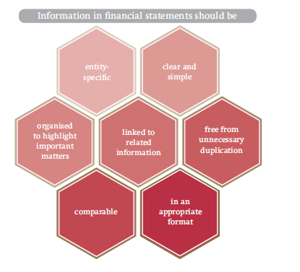
Principles of effective communication
12
Ineffective communication can make financial statements difficult to understand and analyse
Information in financial statements should be:

Slide 13
Roles of primary financial statements and notes
13
Entities have difficulty judging whether information should be provided in the primary financial statements or the notes
Component of financial statements | Role
Primary financial statements are statements of: financial position financial performance changes in equity cash flows | To provide a structured and comparable summary of an entity’s recognised assets, liabilities, equity, income and expenses
Notes | To explain and supplement the primary financial statements

Slide 14
Location of information
14
Information duplication and fragmentation can make financial statements less understandable and difficult to analyse
Information necessary to comply with IFRS Standards may be placed outside financial statements, but within annual report if
annual report more understandable
financial statements understandable
information is faithfully represented, cross-referenced and clearly identified
Annual report
Financial statements
Information labelled as ‘non-IFRS’ may be placed within the financial statements if listed, clearly identified and explained

Slide 15
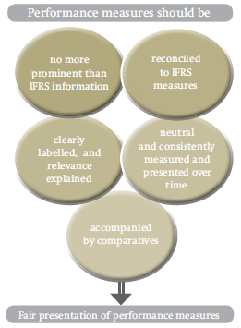
Use of performance measures
15
Can provide useful information if used correctly
Can be misleading if used incorrectly
Use of performance measures should be:

Slide 16
Disclosure of accounting policies
16
Users commonly express concerns about ineffective disclosure of accounting policies
Guidance could:
Clarify which accounting policies are necessary for understanding the financial statements
Explain how to better organise and locate accounting policies and significant judgements and assumptions

Slide 17
Disclosure objectives and requirements
17
Problems
Some Standards lack clear disclosure objectives
Some inconsistencies and unclear relationships between disclosures requirements
Possible approaches
Central set of disclosure objectives as a basis for more unified disclosure objectives and requirements
Approach developed by the NZASB staff for drafting disclosure objectives and requirements in Standards
Prescriptive disclosure requirements

Slide 18
Centralised disclosure objectives—Method A
18
Focusing on types of information
Information about:
- the reporting entity;
- methods, assumptions and judgements;
- items in the primary financial statements;
- unrecognised items;
- risks and other uncertainties
- management’s stewardship;
- events after the end of the reporting period.
Example of centralised disclosure objective
Disclose information about changes in an entity’s investment in property, plant and equipment for users to understand how transactions and events during the reporting period have changed the entity’s financial position, financial performance or cash flows.

Slide 19
Centralised disclosure objectives—Method B
19
Focusing on entity’s activities
Information about:
- the reporting entity;
- methods, assumptions and judgements;
- operating and investing activities;
- financing activities;
- discontinued operations; and
- taxation.
Example of centralised disclosure objective
An entity shall provide disclosures that enable users of financial statements to evaluate changes arising from financing activities, including both changes arising from cash flows and non-cash changes. [*]
[*]: Example of centralised disclosure objective for liquidity and solvency

Slide 20
NZASB staff approach
20
Objectives (standard-level)
Overall disclosure objective
Disclosure requirements
Tier 1—Summary information
Tier 2—Additional information (if necessary)
Disclosure subobjectives
The approach:
emphasises the use of judgment; and
uses less prescriptive language.

Slide 21
Timetable of project and further information
IFRS Foundation
Copyright © IFRS Foundation. All rights reserved

Slide 22
Expected project timetable
22
2 October 2017
Comments due
30 March 2017
Discussion Paper published
2018
Board redeliberations
Feedback on Discussion Paper will also inform
Primary Financial Statements project
Standards-level Review of Disclosures project

Slide 23
Contact us

